Slide 1

Pajak Penghasilan Migas berdasarkan PMK 79/2012
Corporate & Dividend Tax (C&D Tax) based on MoF Regulation No 79/2012

Slide 2

Corporate & Dividend Tax Background
- C&D Tax in PSC is : Government portion of production sharing paid in cash which treated as income tax, as a PSC’s development to accommodate Contractors Tax obligation in their country and GOI cash management as well.
Because of its nature of business, Income Tax for PSC embrace lex specialis principle which implemented in : C&D Tax calculation & payment mechanism ,fixed rate for Corporate Tax along the PSC, uniformity principle for cost , audit mechanism, etc.
in 2010, GOI issued GR 79 regarding cost recovery and income tax treatment in oil & gas industry. This regulation changed a lot of PSC economics valuation by changing the cost recovery calculation, Tax for other income such as: uplift, transfer of participating interest, VAT and other indirect tax to be expensed, etc.
For C&D Tax, GR 79 remove the possibility for GOI share reduced by using tax treaty and also changed the reporting mechanism (and audit as well). Ministry of Finance (MoF) issued Mof Regulation No 79/2012 regarding C&D Tax mechanism
PMK 79 2012.docx

Slide 3
PSC CALCULATION
Barrels of Crude
US Dollars
Beginning 5,000
ICP (wap) $40/bbl
Gross Revenue 2,000,000
Production 55,000
Lifting 50,000
Ending 10,000
US Dollars
FTP 20% 400,000
OPERATING COSTS 800,000
Non-Capital
C/Y Non-Capital 675,000
Cost Recovery 800,000
US Dollars
C/Y Depreciation 125,000
P/Y Unrecovered Costs 0
EXPENDITURES
Equity to be Split 800,000
Capital
271,000
675,000
Expl & Dev
49,000
440,000
Production
CONTR. Share
346.154
BPMIGAS Share
853,846
216,000
186,000
Gen & Admin
DMO 144,232
6,000
49,000
DMO Fee 144,232
Depreciation 125,000
- C/Y Assets 75,000
- P/Y Assets 50,000
Tax 166,154
Assets PIS
300,000
At rate of 25%
Net Contr. Share
180,000
Indonesia Share
1,020,000
Notes:
BPMIGAS/Contractor Share : 71.1538%/28.8463%
Tax 48%; DMO Fee : new oil
Total Contr. Share
980,000

Slide 4
How to calculate C&D Tax
Gross Revenue
INCOME TAX
FTP
Inv.Credit
Contractor Gross Income:
(+) Investment Credit
(+) Cost Recovery
(+) FTP & Equity Share
(-/+ ) DMO & DMO Fee
(+) Lifting PriceVariance
Costs/Tax Deductions:
- Cost Recovery
- Bonuses (PSC 2008 onward
excludes bonuses)
Taxable Income (1) – (2)
- Corporate Income Tax
- Branch Profit Tax
Cost Recovery
Equity to be Split
BPMIGAS
Share
CONTRACTOR Share
DMO
DMO Fee
Gov’t Tax
Indonesia
Share
Net Contr. Share
Cost
Recover-able
Total Contr.Share
OTHER INCOME TAXES

Slide 5
How to calculate C&D Tax
  ENTITLEMENT APPROACH :
  LIFTING APPROACH :
(1) Contractor Gross Income:
(+) Equity Share
(+) FTP Share
(+) Cost Recovery
(+) Investment Credit
(-) DMO
(+) DMO Fee
(+) Lifting Price Variance
(1) Contractor Gross Income:
(+) Contractor Lifting
(+) DMO Fee
(+) Cash Settlement
(2) Deduction:
(+) Cost Recovery
(+) Lifting Price Variance
(2) Deduction:
(+) Cost Recovery
(3) Taxable Income (1) – (2)
=
(3) Taxable Income (1) – (2)
(4) Tax Due - x% of (3)
=
(4) Tax Due – x% of (3)
Either Entitlement Approach or Lifting Approach should come up with the same figure
Example : using data from previous slide -ECS test-tax.xlsx

Slide 6
C&D Tax Process in WMO
Monthly ECS
C&D Tax calculation
Request for payment email to PHE
Payment Slip from PHE
Request validation schedule to DJA
C&D Tax report
Approval form WMO management
C&D Tax report, SSP & Payment Slip
Validation SSP & report C&D Tax & SSP sheet 2 to DJA
Report C&D Tax & copy SSP to SKK MIGAS
Report C&D Tax & SSP sheet 3 to Tax Office
END

Slide 7
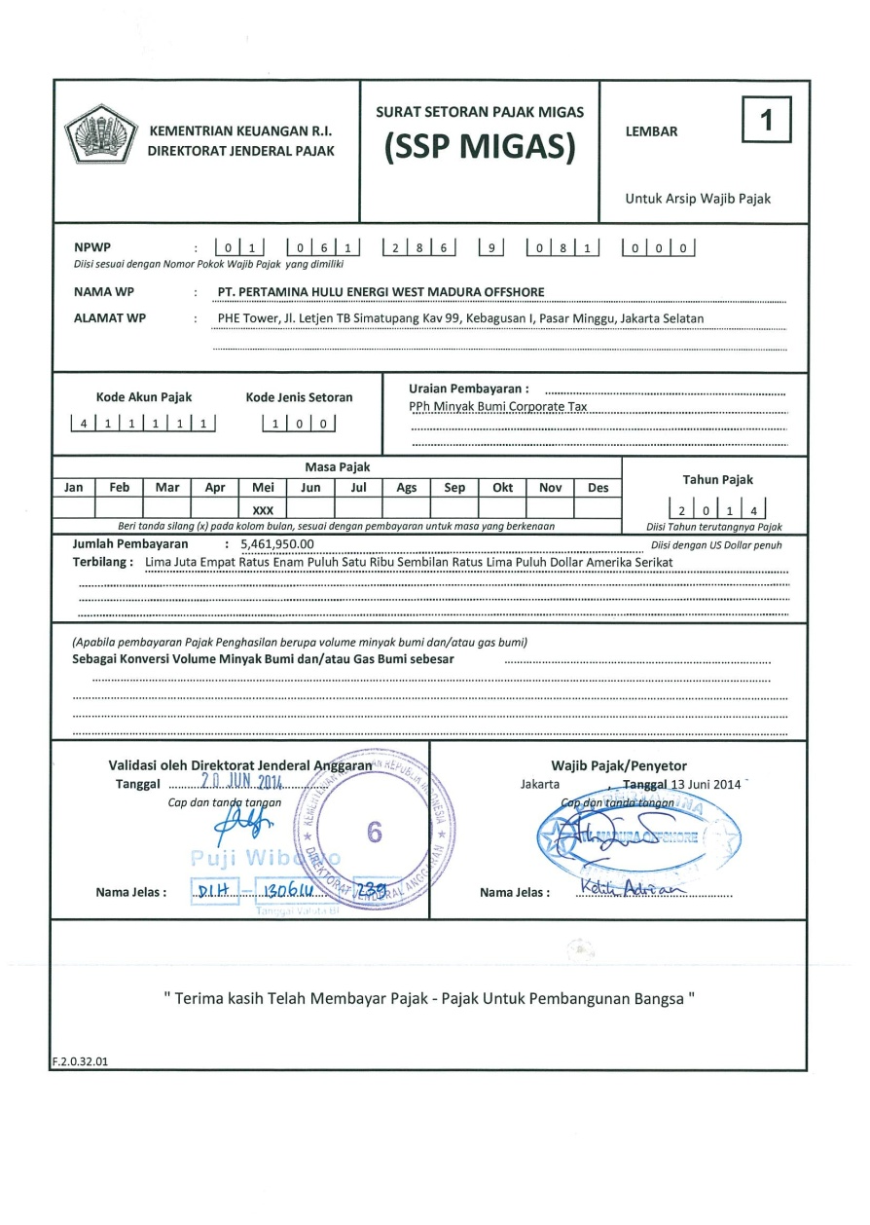
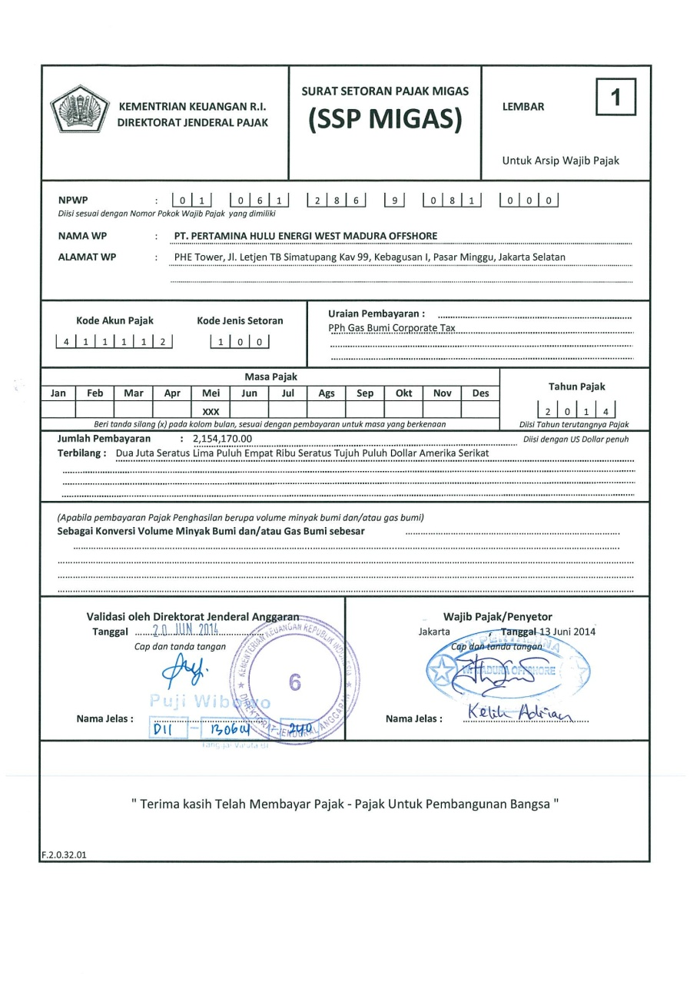
C&D Tax Report Documents : SSP (1)

Slide 8
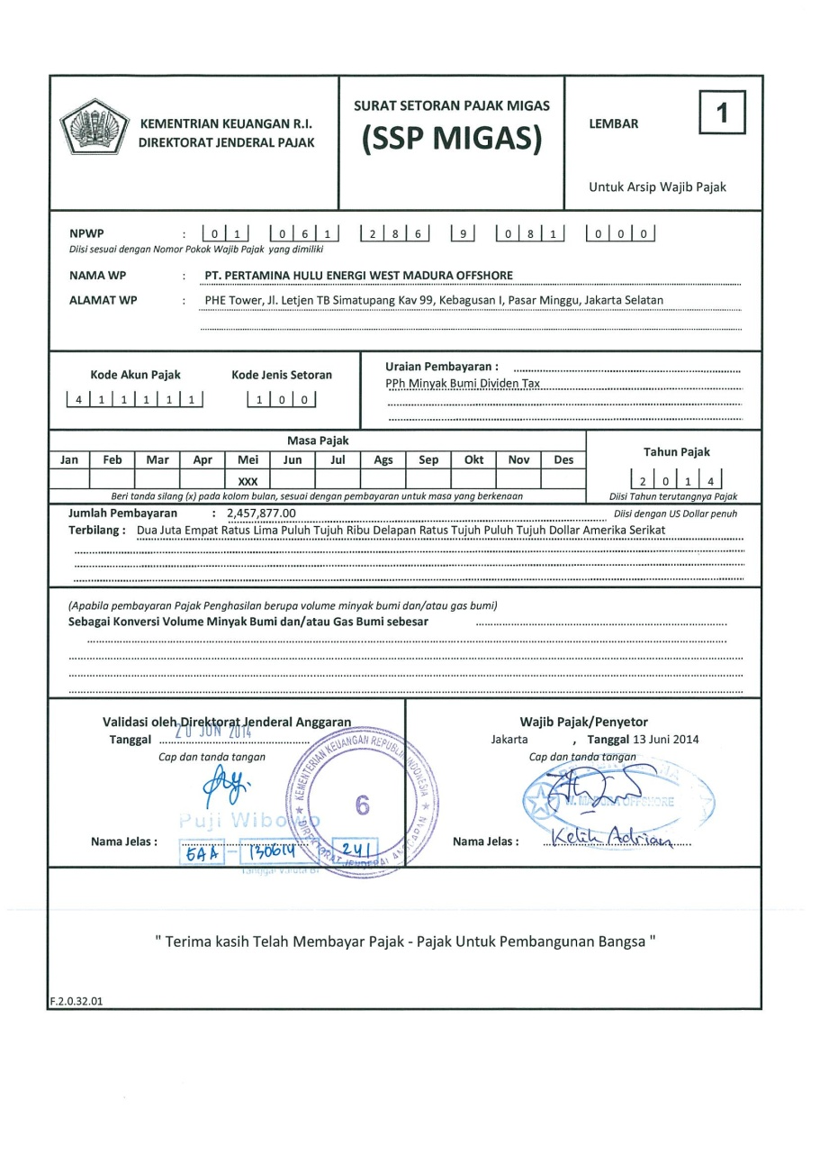
C&D Tax Report Documents : SSP (2)

Slide 9
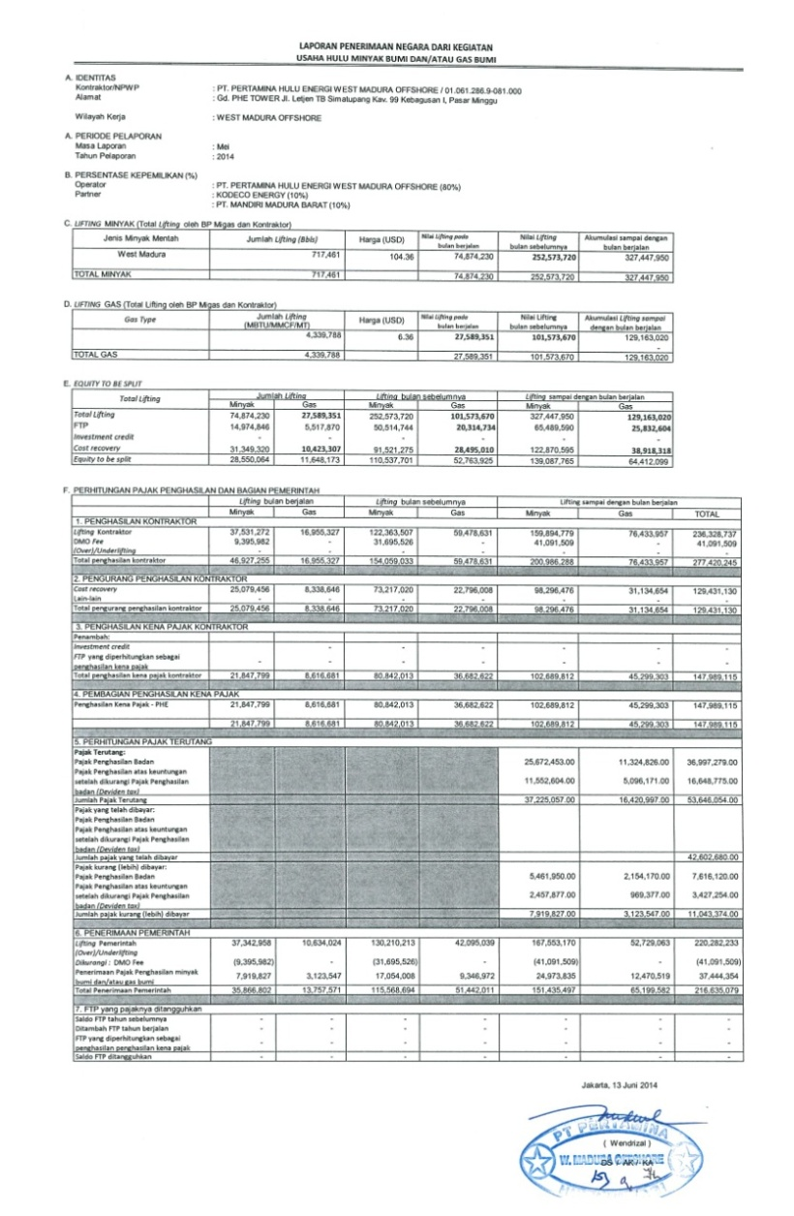
C&D Tax Report Documents : LPN
Example : using data from previous slide -example LPN.xlsx

Slide 10

“Develop a passion for learning. If you do, you will never cease to grow” – Anthony J.D’Angelo-

